Slide 1
Unlocking longevity
The science behind youth extension
Navigating the overwhelming landscape of longevity research and commercial claims
Jesus Gonzalez Vazquez
Capstone project
Neuefische school and pool of digital talent

Slide 2
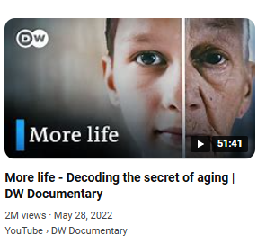
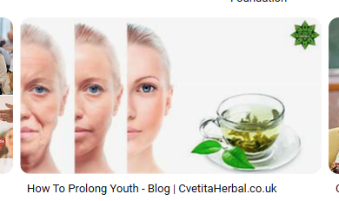
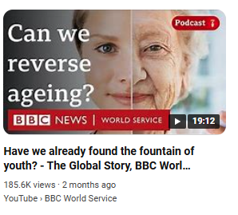
Problem:
Growing interest on longevity
Scientific contribution frequency
Challenges of information overload
Importance of reliable research
Rise of dietary supplements
Claims of the fountain of youth

Slide 3
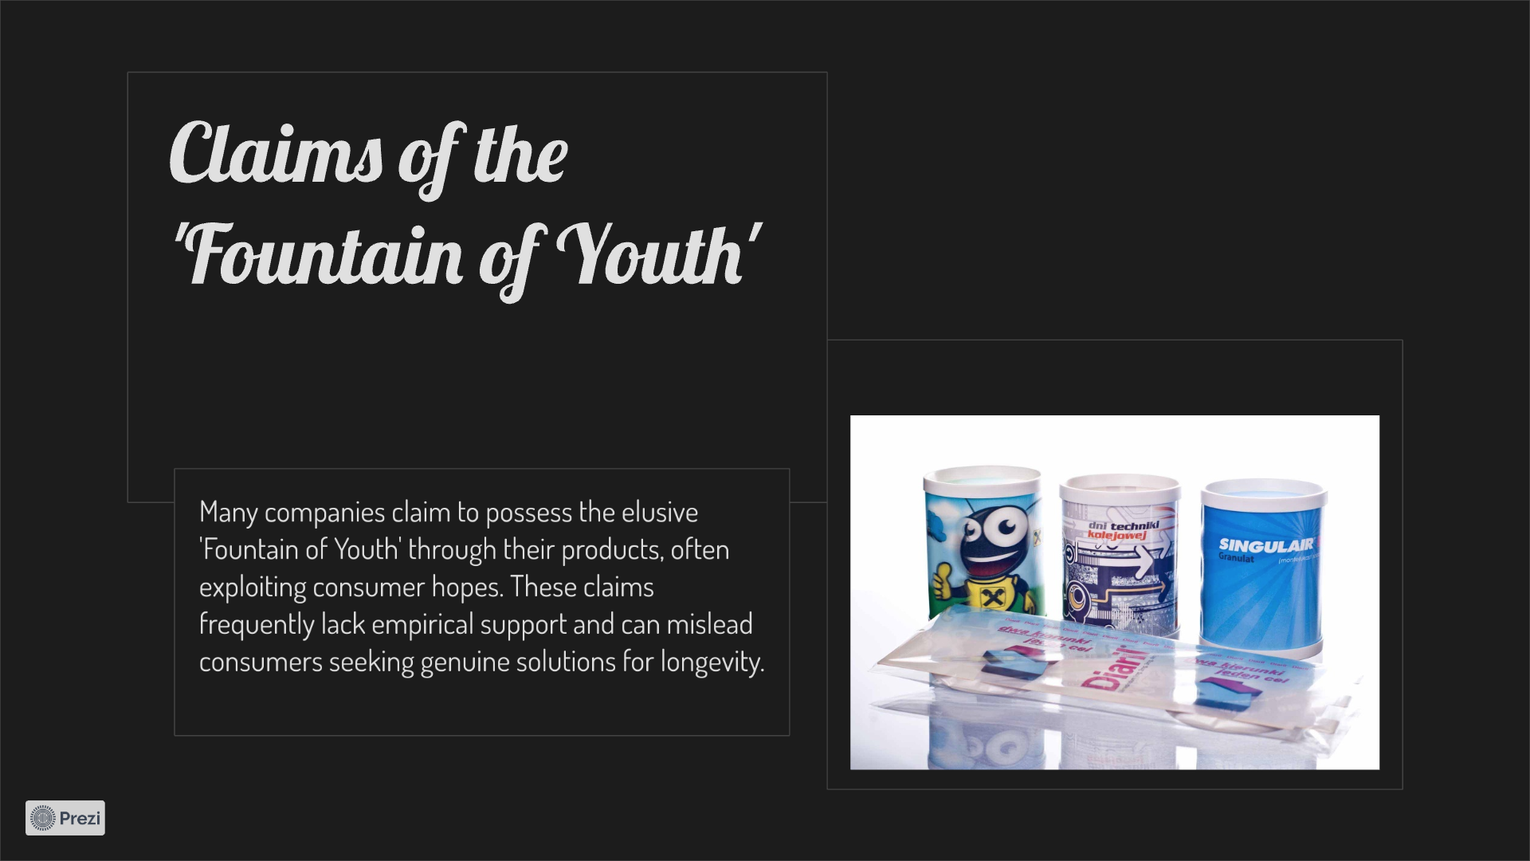
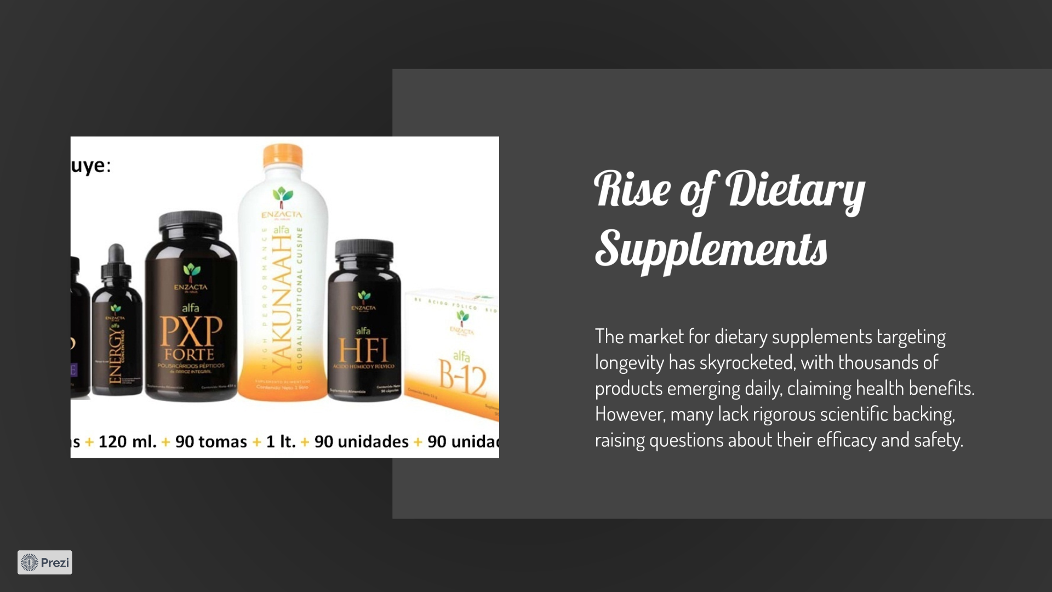
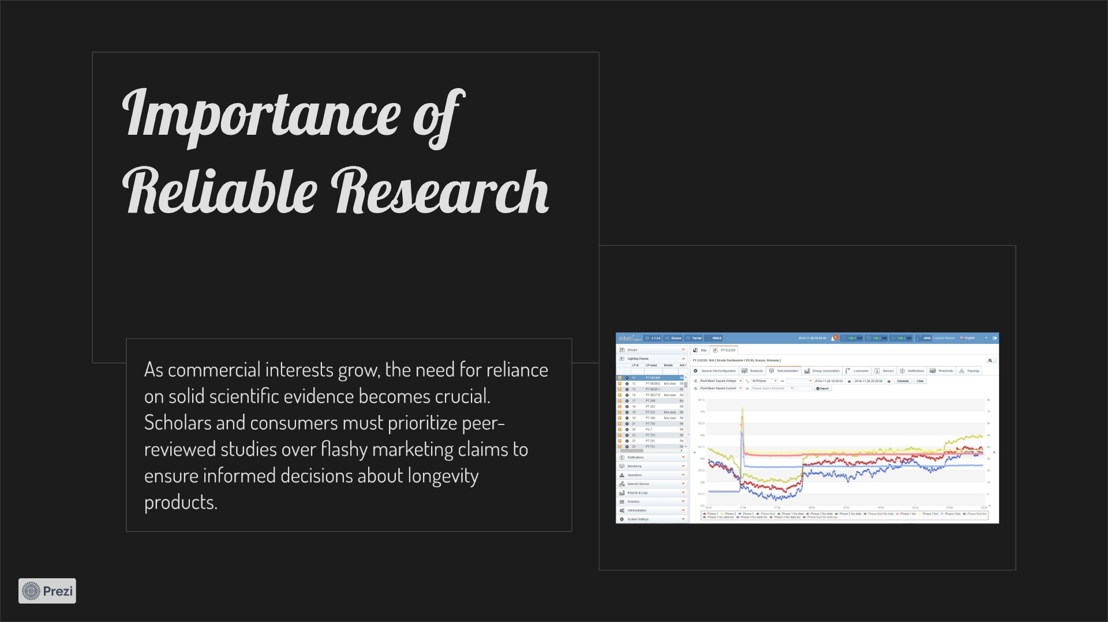
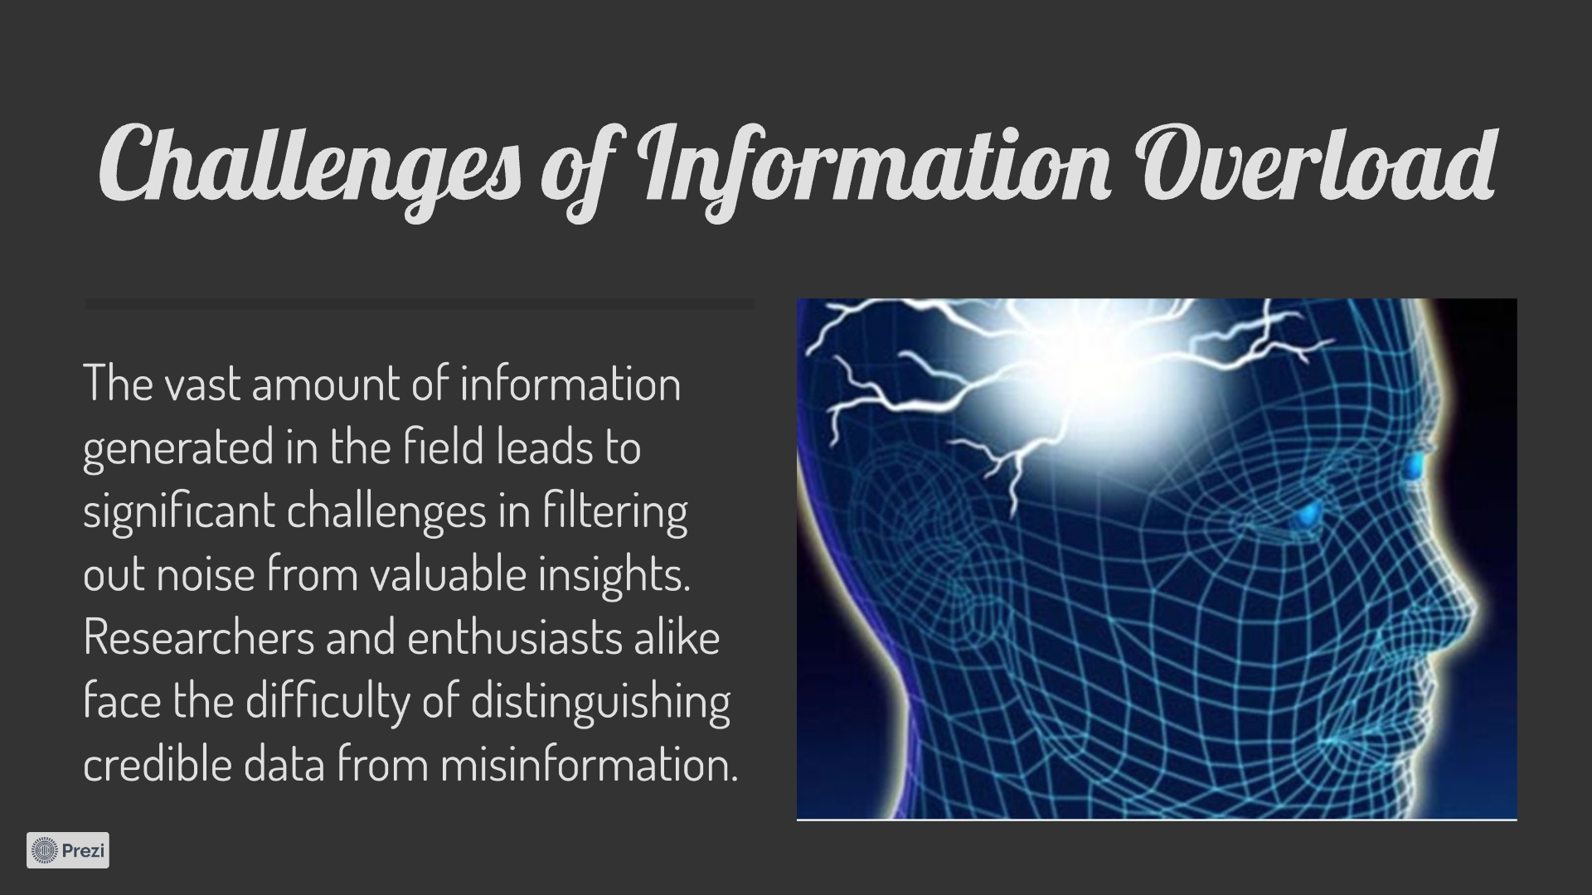
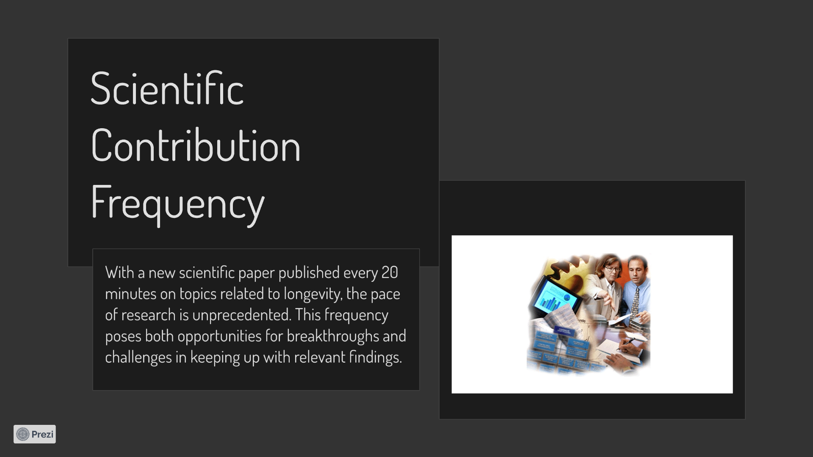
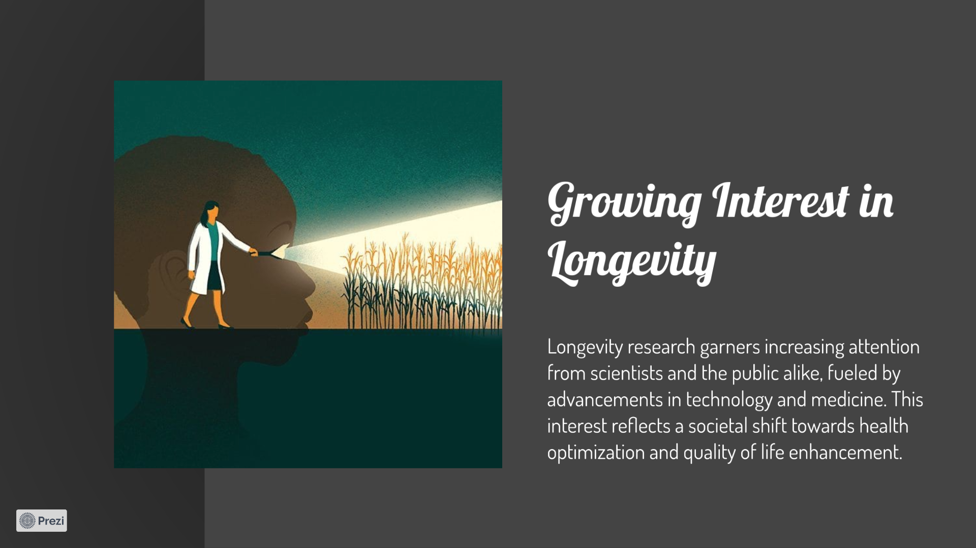
Problem:
Growing interest on longevity
Scientific contribution frequency
Challenges of information overload
Importance of reliable research
Rise of dietary supplements
Claims of the fountain of youth

Slide 4
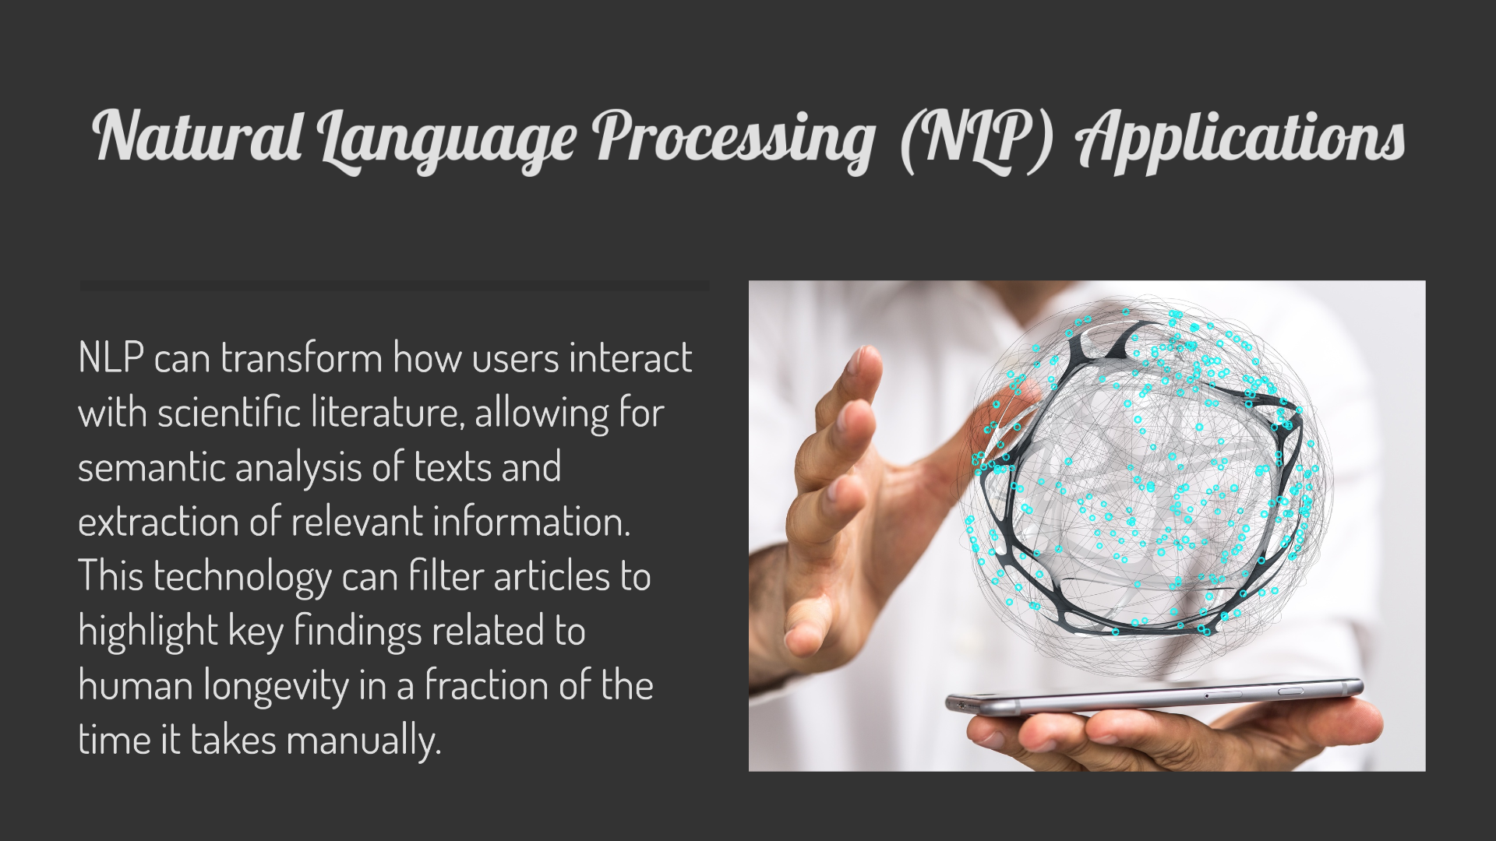
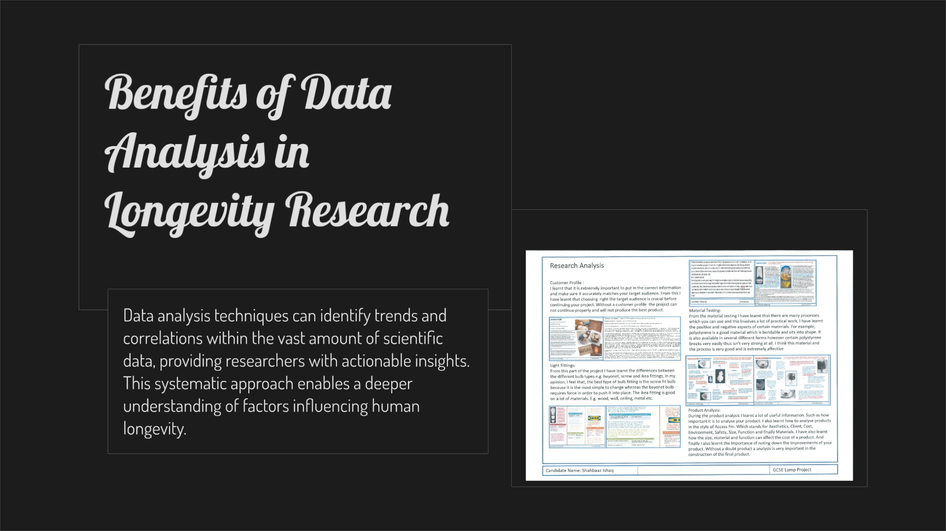
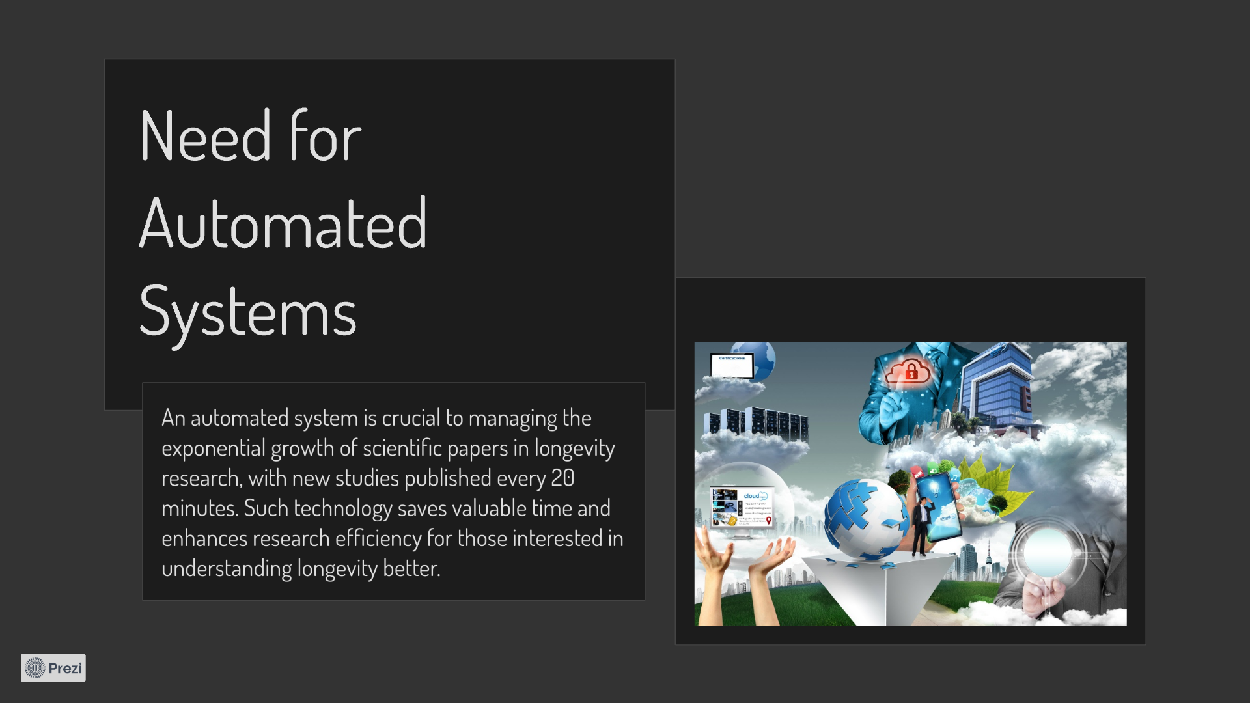
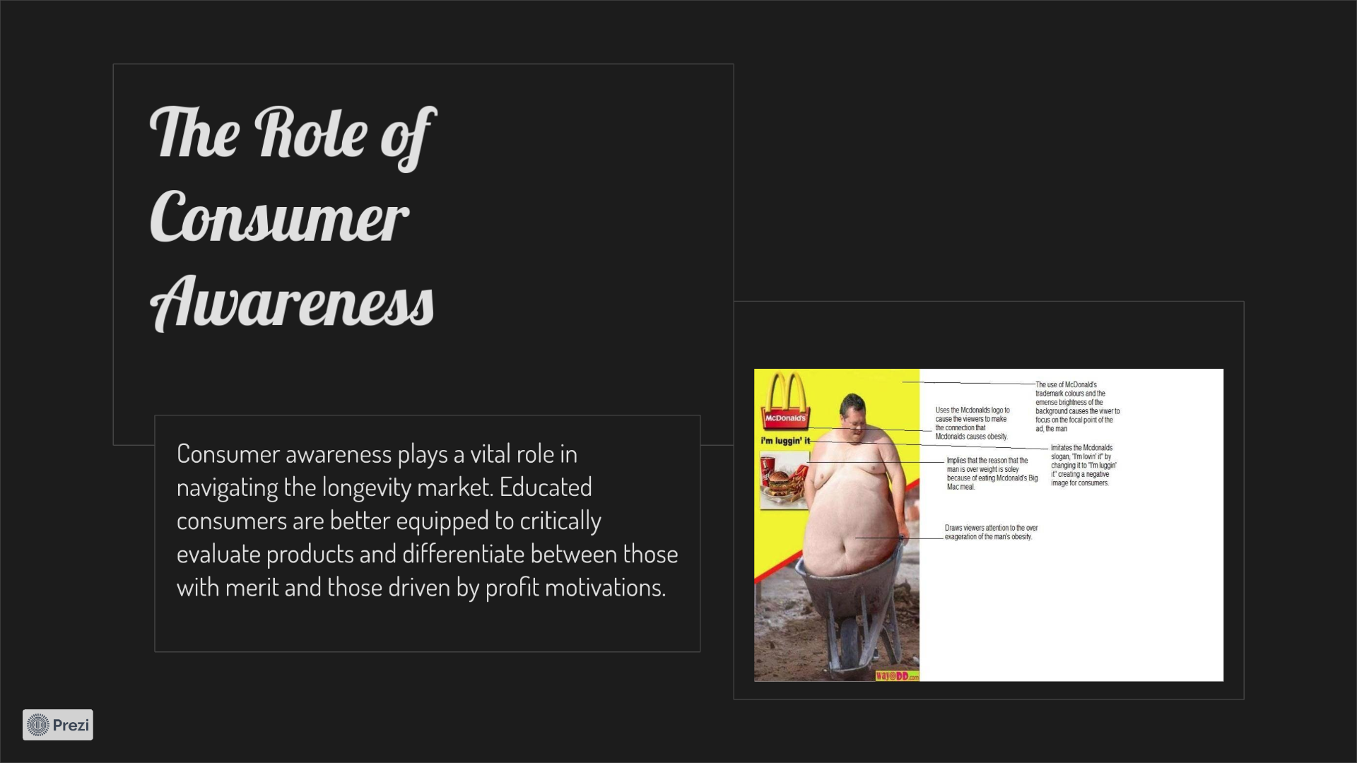
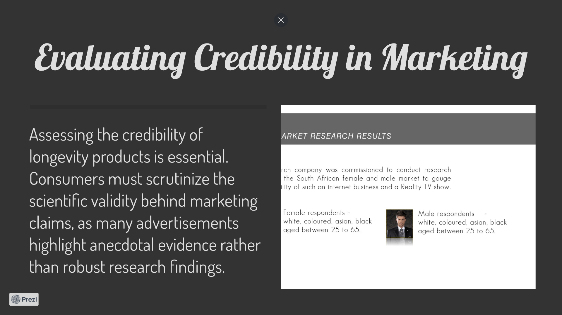
Solution:
Evaluating credibility in marketing
The role of consumer awareness
Need for automated systems
Benefits of data analysis in longevity research
NLP applications

Slide 5
Our contribution: Extending Youth Scientifically
A data science and AI based application that filters scientific information and articles from multiple sources and helps to classify, summarize and assigns relevance to these articles, which can change over time, providing insights into longevity news and understands audience interest

Slide 6
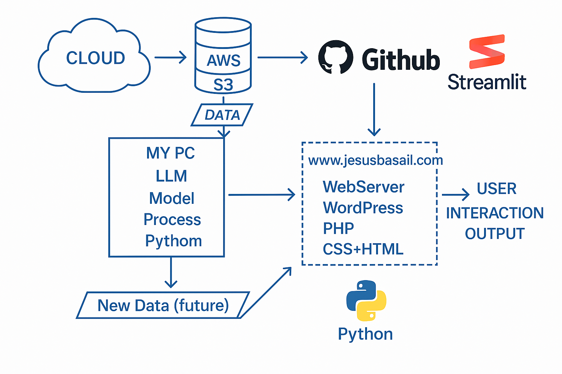
Tech Stack & Tools:
Data: Web Scraping APIs
Hosting: IONOS www.jesusbasail.com
Backend: PHP, Python, GitHub
Frontend: Wordpress / Streamlit
Engine: LLM: Meta-Llama-3-8B / all-mpnet-base-v2
Storage for Scraping: AWS- S3

Slide 7
Features & Functionality
• Key Features:
1. Real-Time News Feed: Aggregates the latest news from various trusted sources.
2. Aging Algorithm: Analyzes articles based on how engagement changes over time (comments, shares, etc.).
3. User Dashboard: Allows users to see how news stories evolve in relevance and engagement.
4. Search Functionality: Users can search and filter news based on age, topic, and source.

Slide 8
Code & Technical Details
Content:
• Code Snippet:
"Here’s a simple function that fetches news articles based on a specific keyword and tracks the number of shares and comments over time."
• def fetch_news_data(keyword):
• # Fetches articles based on the keyword and analyzes user engagement
• articles = get_articles_from_api(keyword)
• for article in articles:
• analyze_engagement(article)
• return articles
• Challenges:
o Challenge 1: Scraping data from dynamic websites with JavaScript content.
o Solution: Used Selenium with Python to dynamically load JavaScript-based content.
o Challenge 2: Managing the aging data (especially in terms of user engagement over time).
o Solution: Created an algorithm to monitor the number of shares, comments, and other engagement metrics over set intervals.

Slide 9
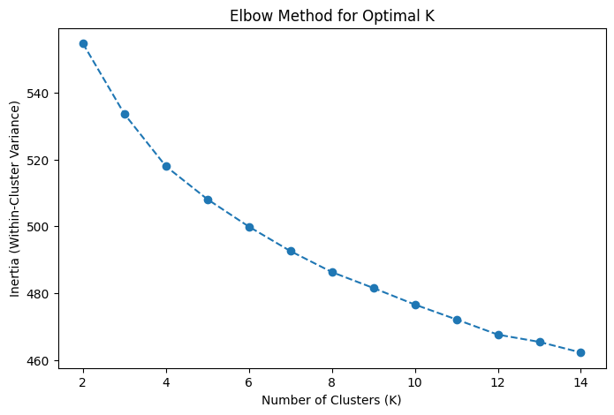
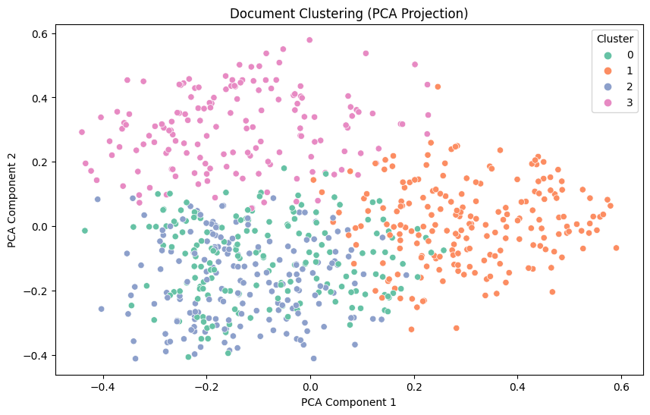
Code & Technical Details
Content:
• Code Snippet:
"Here’s a simple function that fetches news articles based on a specific keyword and tracks the number of shares and comments over time."
• def fetch_news_data(keyword):
• # Fetches articles based on the keyword and analyzes user engagement
• articles = get_articles_from_api(keyword)
• for article in articles:
• analyze_engagement(article)
• return articles
• Challenges:
o Challenge 1: Scraping data from dynamic websites with JavaScript content.
o Solution: Used Selenium with Python to dynamically load JavaScript-based content.
o Challenge 2: Managing the aging data (especially in terms of user engagement over time).
o Solution: Created an algorithm to monitor the number of shares, comments, and other engagement metrics over set intervals.

Slide 10
Product launch
Q3
Market research
Q4
Product development
Q1
User testing
Q2
Product launch
Currently gearing up for a ground-breaking launch
Our new offerings will captivate the market
Our marketing campaign will generate anticipation

Slide 11
Results / Outcomes
Metric | Current value | Previous quarter | Change (%)
Revenue | $2,500,000 | $2,200,000 | +14%
Operating expenses | $1,200,000 | $1,400,000 | -14%
Net profit | $1,000,000 | $800,000 | +25%
Operating margin | 40% | 36% | +4%
Cash reserves | $5,000,000 | $4,500,000 | +11%

Slide 12
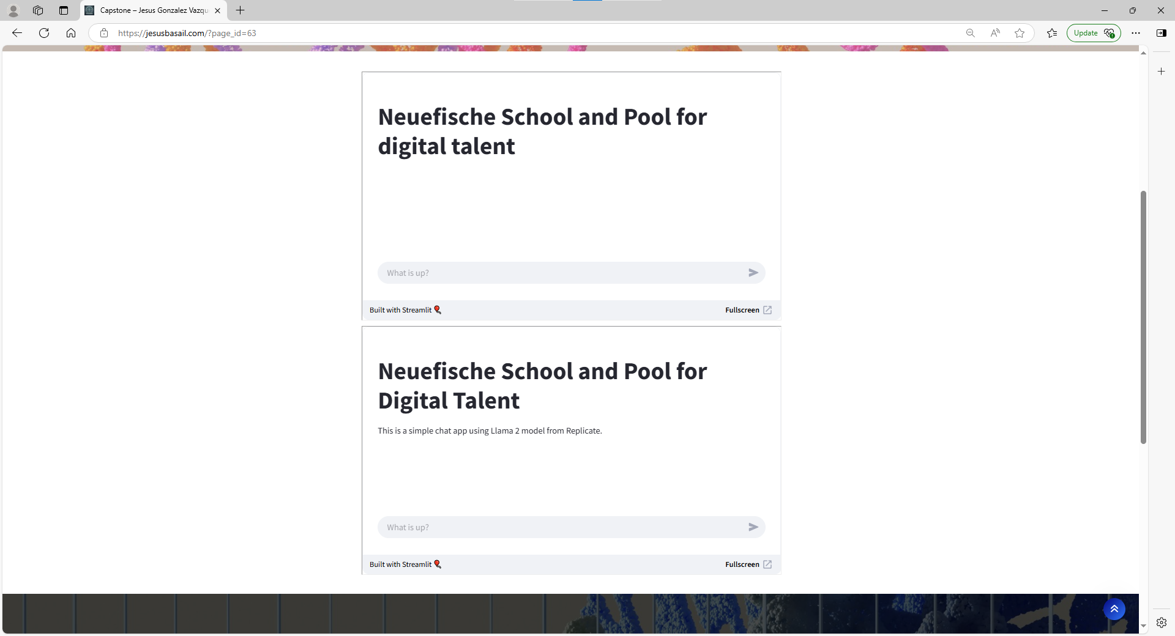
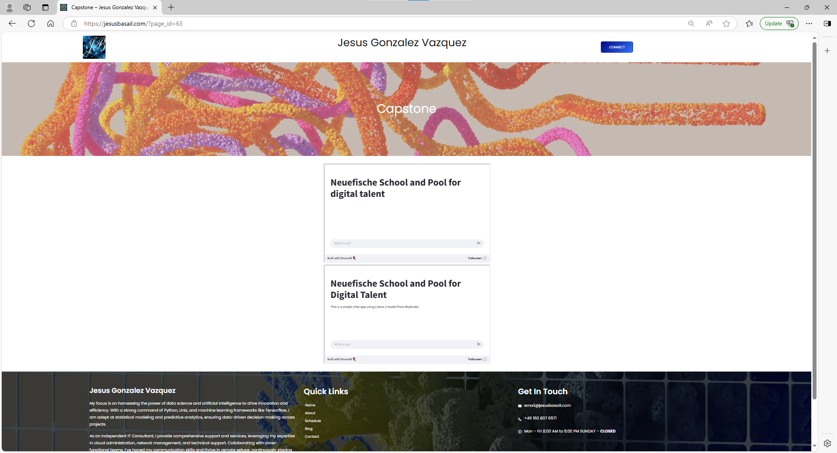
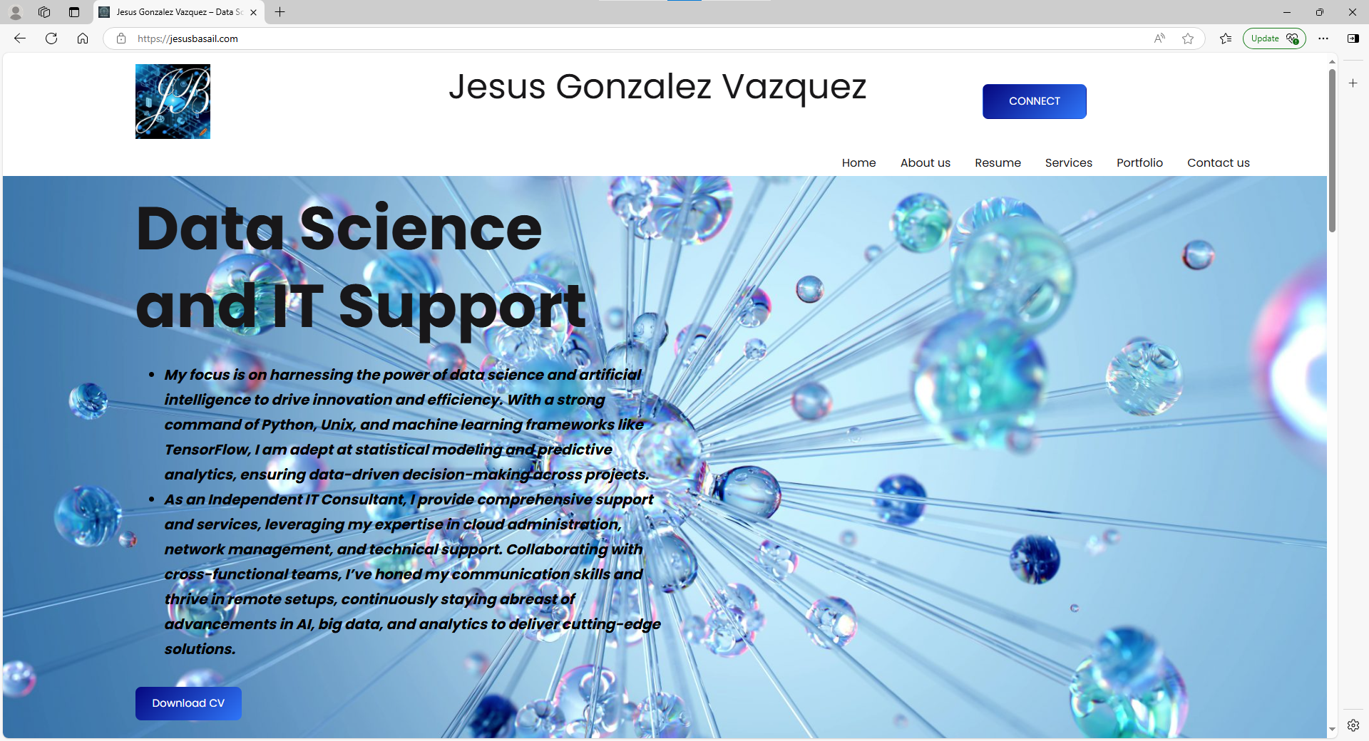
Results / Outcomes
Jesus Gonzalez Vazquez – Data Science and IT Support

Slide 13
Conclusion & Future Work

Slide 14
Future:
• Conclusion:
"Aging News provides valuable insights into how news evolves over time, offering users a new perspective on news consumption. The project has shown great potential for application in media companies, content managers, and data scientists."
• Future Work:
o Implement machine learning to predict news relevance in the future.
o Add more robust filtering options (e.g., based on region, publication, etc.).
o Explore ways to automate news categorization based on sentiment analysis.

Slide 15
Thank you, questions?
Jesus gonzalez vazquez
+49 160 807 6571
email@jesusbasail.COM
WWW.jesusbasail.COM

